Slide 1

GYM APP
Jadara University
Faculty of Science and Information Technology
Done By:
Student 1 – ID
Student 2 – ID

Slide 2
GYM APP
Enhance the relation between the coaches and trainees to ensure best results also, we seek to achieve these goals: -
Save time in communication.
Monitor the progress of the trainee.
Enable the trainer to perform online tasks.
Enable the trainee to switch from coach to coach.

Slide 3
Problem Statement
Trainees face several issues while training, which lead to lost time, changes of the weight, from the coach side, don't focus on training and in manage the relationships with trainees and following them.

Slide 4
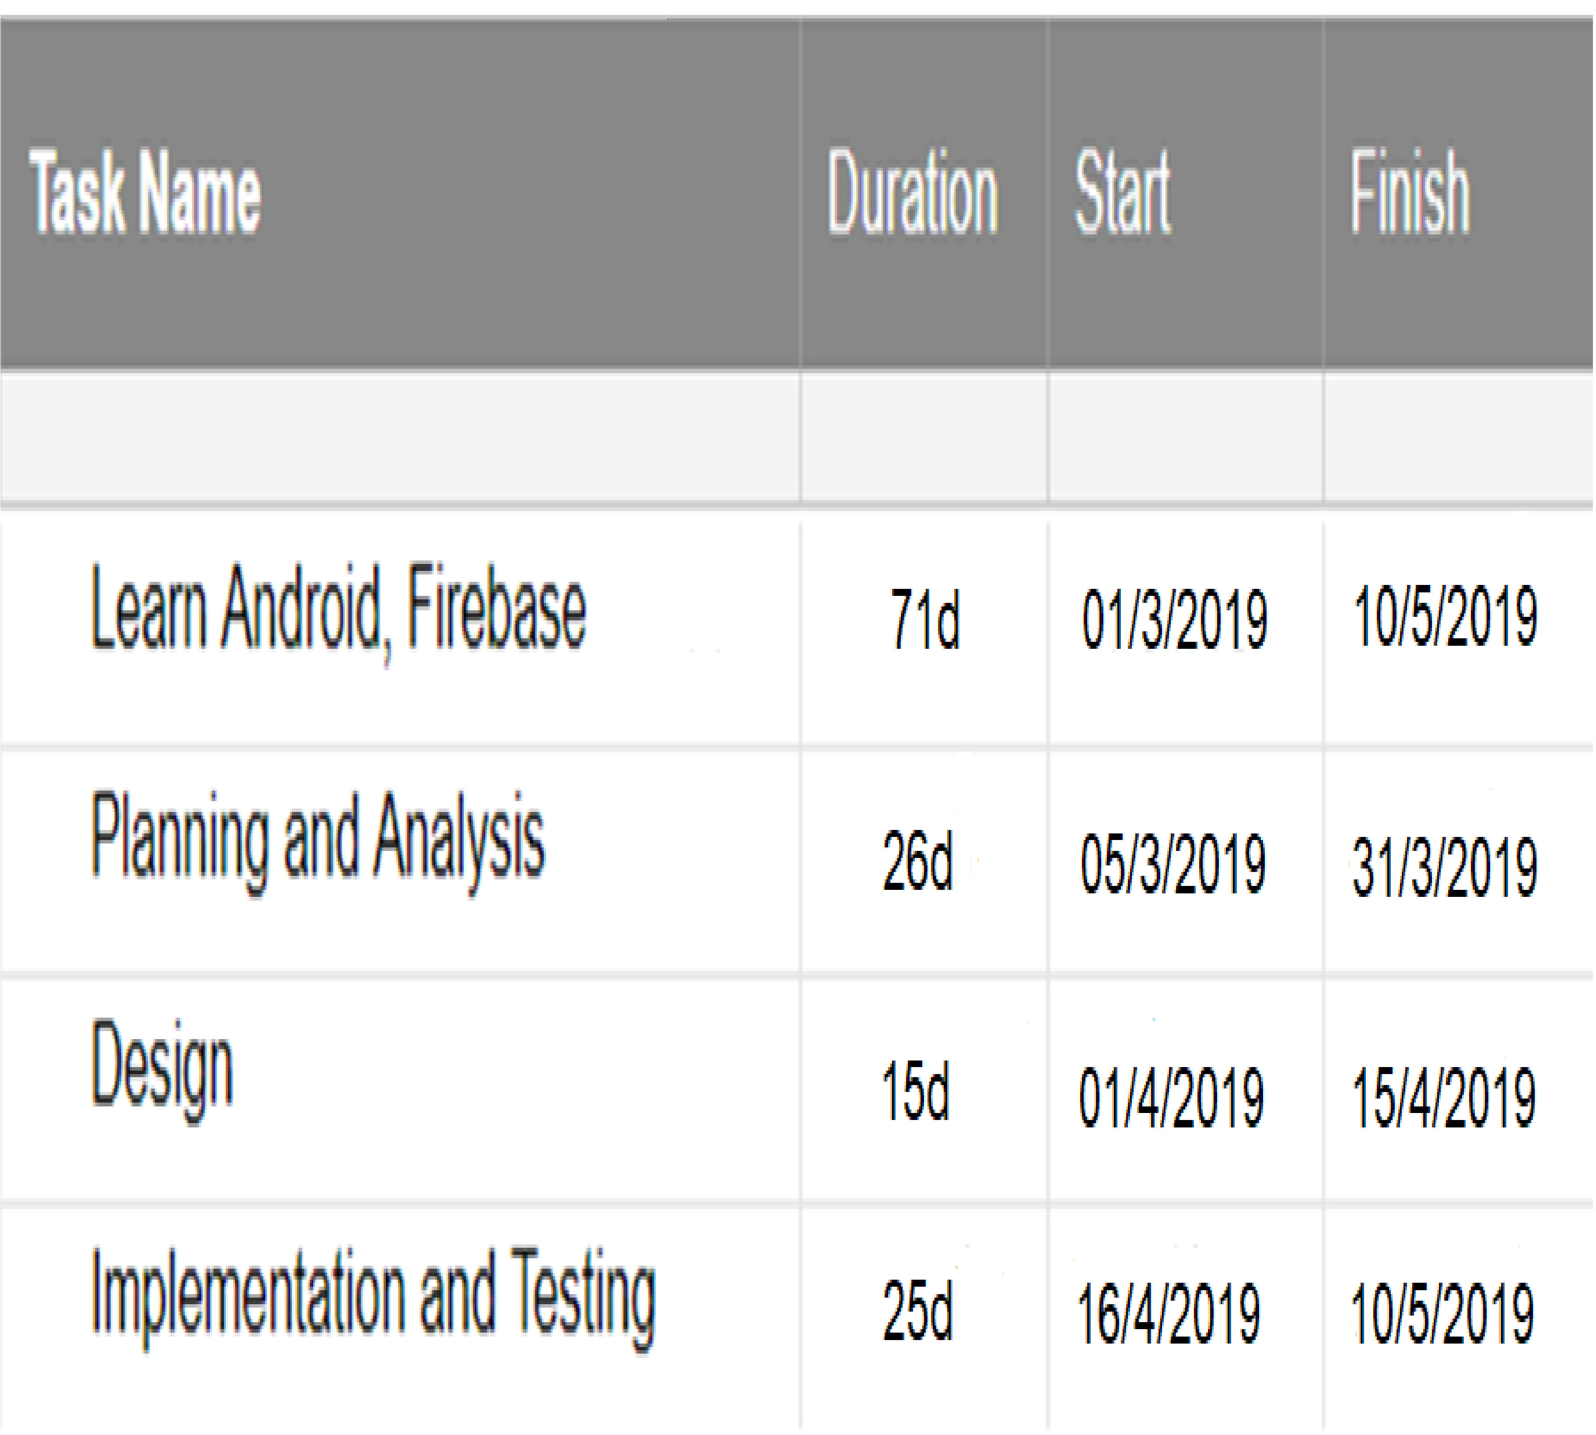
Gantt Chart

Slide 5
Related work
# | The Training Note Book | Coach Pro | FitSW
Advantage | store before and after pictures | Groups | tracking self trainee
Disadvantage | No interact between trainer and trainee | No interact between trainer and trainee | No interact between trainer and trainee

Slide 6
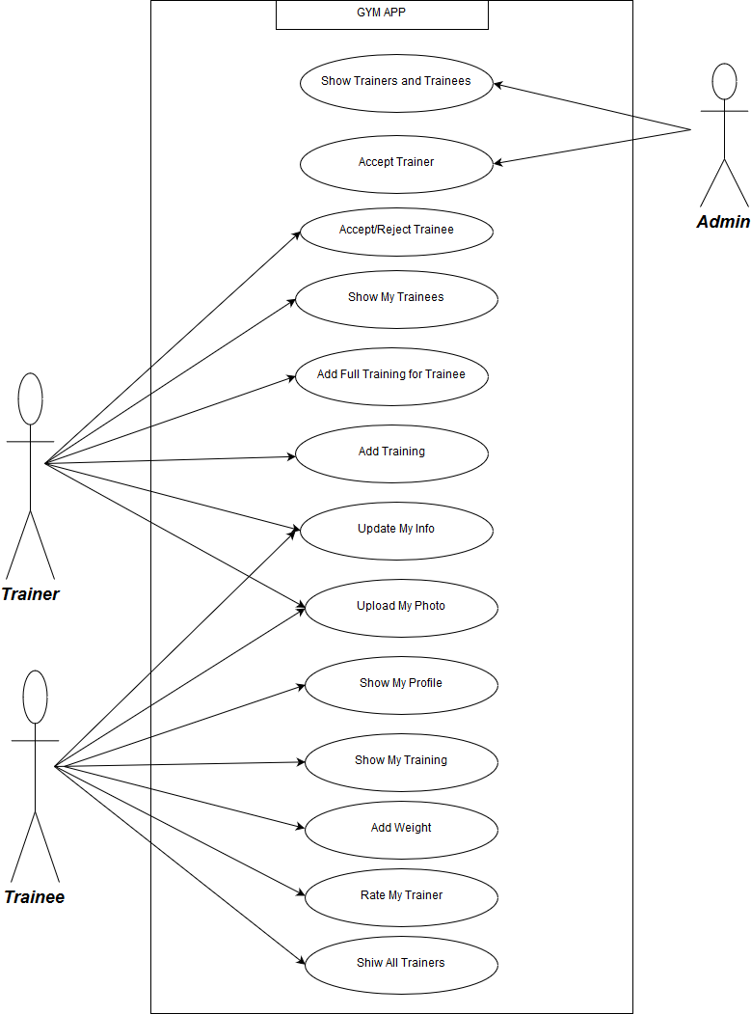
Use Case Diagram

Slide 7
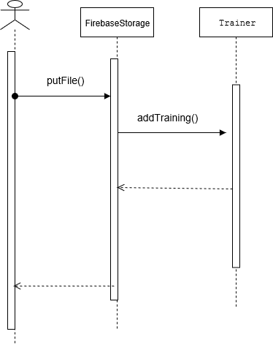
Sequence Diagram for How Add Training?

Slide 8
Future Work
In the near future, complete all requirements and add functionalities will be added to this system, these functions will be like:
Improved application design
Authentication mobile number.
Add payment method.
Push Notifications.

Slide 9
what learned from graduation project ?
Ability to learn any modern technology.
Big experience in Android and familiar in Java.
Learned several Concepts in NoSQL and Firebase Services (Storage, Realtime Database and Authentication).
Ability to organize time.

Slide 10
Thank You

